Slide 1
Determinants
3.1 Introduction to Determinants
Bumhee Cho

Slide 2
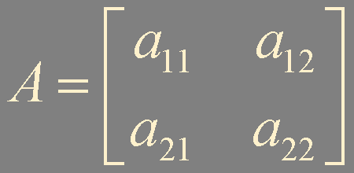

2 × 2 Matrix
invertible if and only if its determinant is nonzero

Slide 3


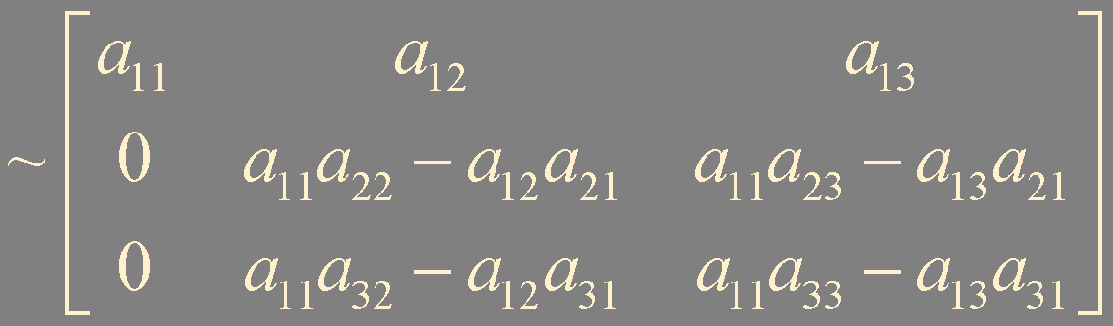
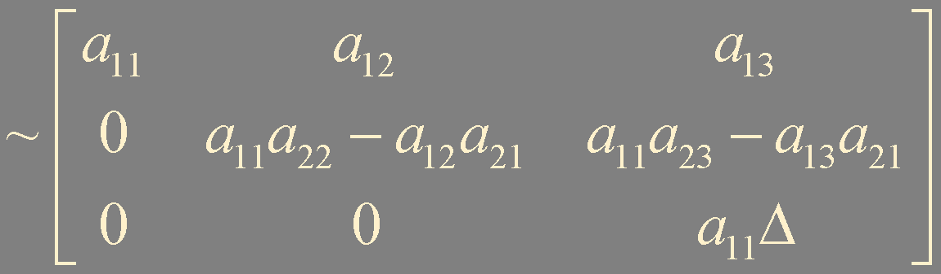
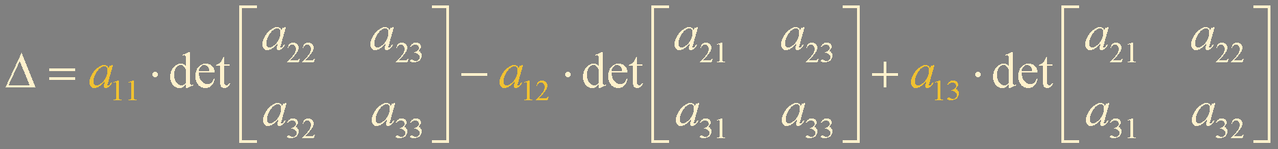
3 × 3 Invertible Matrix
Δ must be nonzero

Slide 4
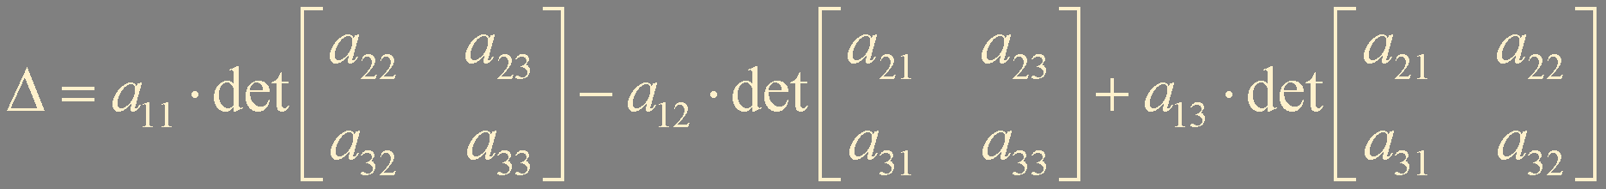

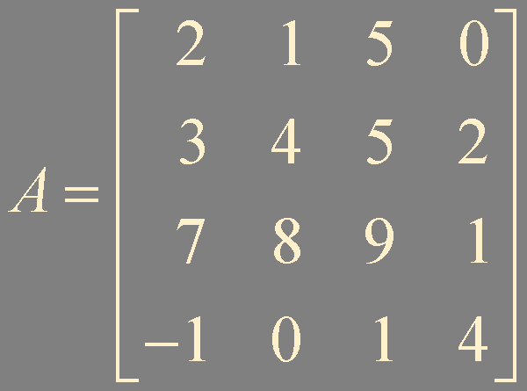
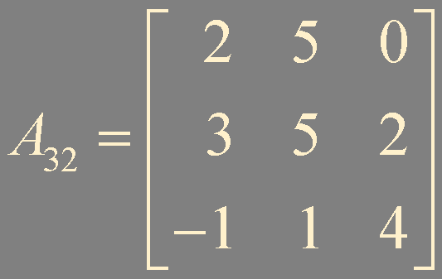

Slide 5

Determinant
For n ≥ 2, the determinant of an n × n matrix A = [a_{i j}] is the sum of n terms of the form ± a_{1 j} det A_{1 j}, with plus and minus signs alternating, where the entries a₁₁, a₁₂, ..., a_{1n} are from the first row of A

Slide 6
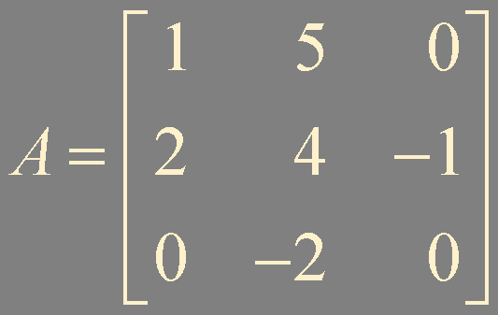
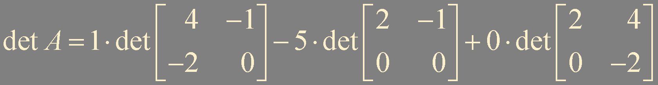
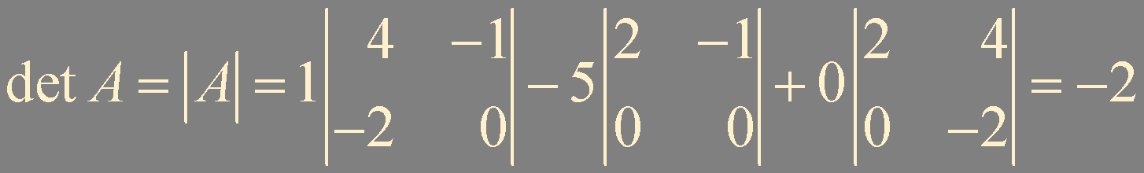
Example 1. Compute the determinant of the following matrix

Slide 7

Cofactor
Given A = [a_{i j}], the (i, j)-cofactor of A is the number C_{i j} given by
C_{i j} = (-1)^{i + j} det A_{i j} = (-1)^{i + j} | A_{i j} |

Slide 8

Theorem 1.
The determinant of an n × n matrix can be computed by a cofactor expansion across any row or down any column. The expansion across the ith row using the cofactors is
The cofactor expansion down the jth column is

Slide 9



Slide 10

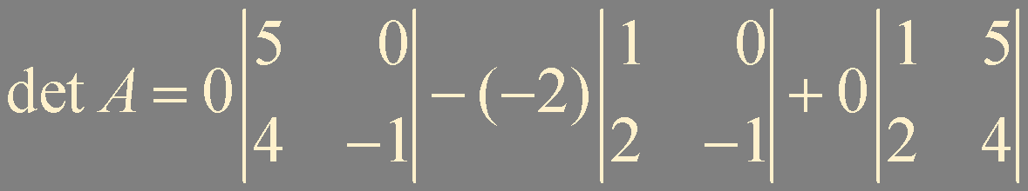

Example 2. Use a cofactor expansion across the third row to compute determinant

Slide 11
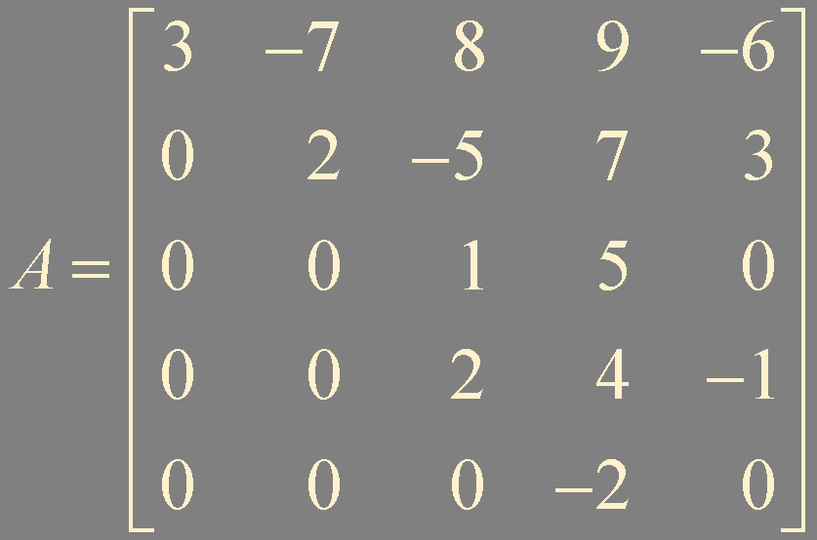
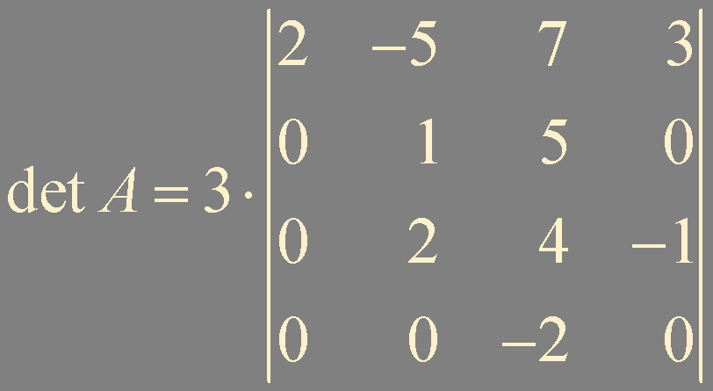
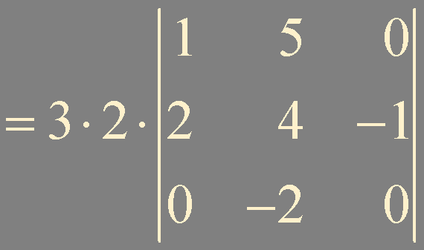


Example 3.

Slide 12
Theorem 2.
If A is a triangular matrix, then det A is the product of the entries on the main diagonal of A

Slide 13


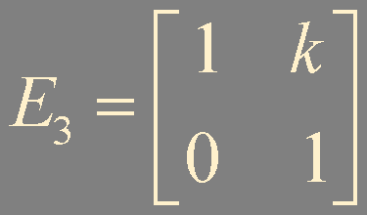
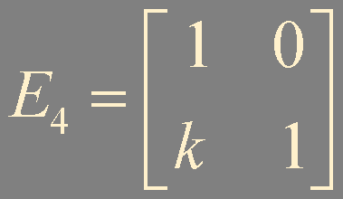



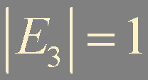


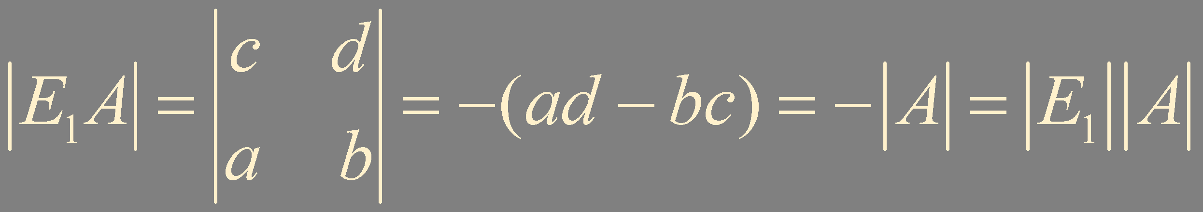
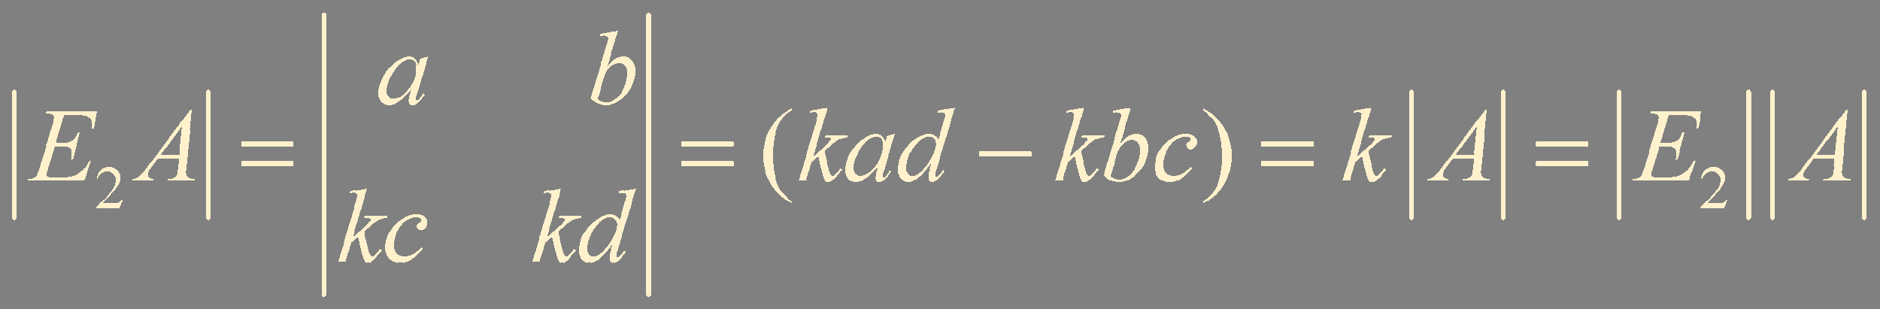
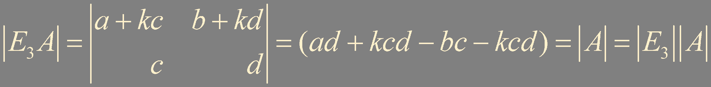
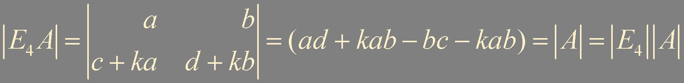
Example 4. Verify det EA = (det E)(det A)

Slide 14
Numerical Note
Consider 25× 25 full matrix
To calculate a determinant by cofactor expansion, it requires over n! multiplications. 25! is around 1.5 × 10²⁵
Assume a computer can perform one trillion multiplications per second
It takes more than 500,000 years

Slide 15
Summary
Determinant
Cofactor expansion

